Slide 1
Introduction to programming in .NET
Who am I and what to expect

Slide 2
Introduce ourselves
Lets talk about you and me

Slide 3
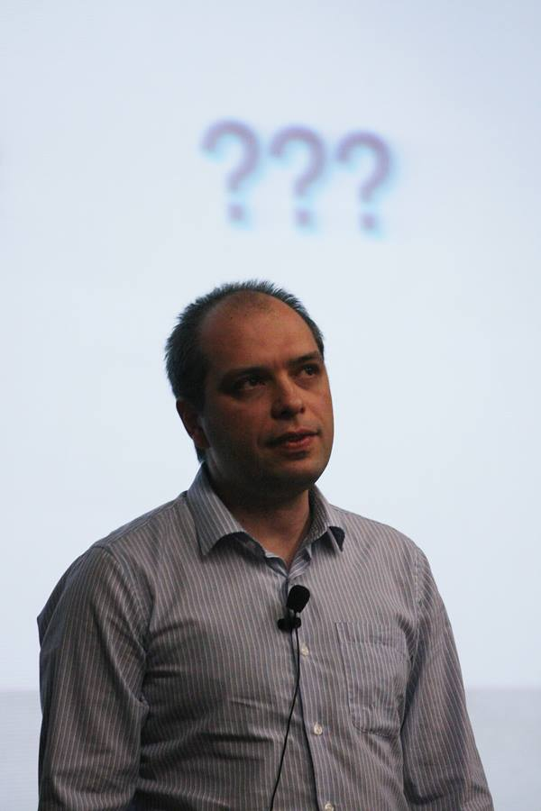
Who am I
Stamo Petkov
Information services Plc.
Microsoft Technologies department
s.g.petkov@is-bg.com
stamo.petkov@gmail.com
https://github.com/stamo
http://www.stamopetkov.eu
http://bg.linkedin.com/in/stamopetkov
https://www.facebook.com/stamo.petkov
@stamo_petkov

Slide 4
My experience
Master of science in Computer Sciences, TU Sofia
More than 15 years of professional experience
BASIC, PERL, C, C++, PHP, C#, JavaScript
Last 5 years .NET, ASP.NET, .NET Core, ASP.NET Core, JavaScript
Teaching experience
SoftUni Basic Programming
SoftUni ASP.NET MVC
InfoStart JavaScript
InfoStart Software Architecture
Speaker on several software conferences

Slide 5
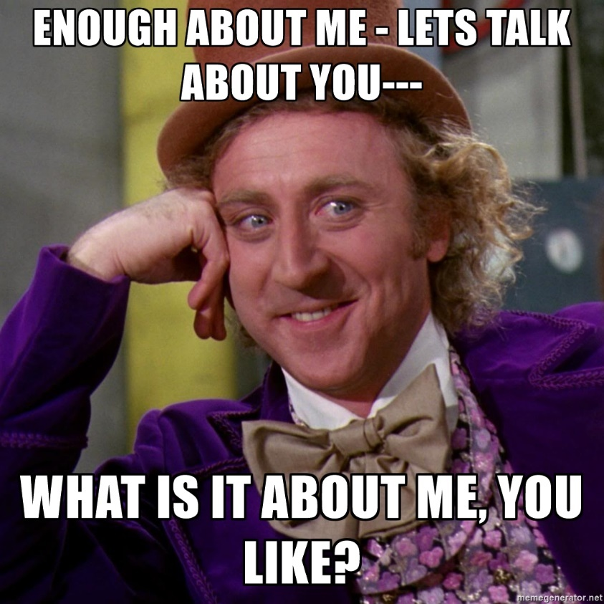
Who are you
Your name
Where and what have you studied
Your programming experience
What do you expect from this course

Slide 6
Prerequisites
What will you need for this course

Slide 7
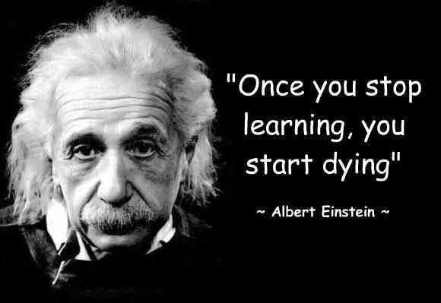
You will need
Willingness to learn
Laptop or PC with MS Windows
Visual Studio 2015 Community edition
Internet connection
Moodle
… did I mentioned willingness to learn

Slide 8
How about the course
schedule and Assessment

Slide 9
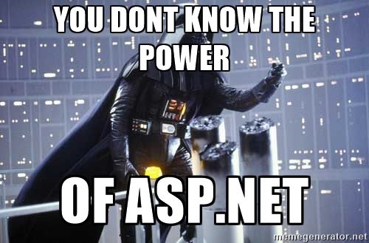
What does this course include
C# basics
You will learn the basic concepts of .NET with C#
Classic ASP.NET
The past. What is this and why we don’t need it
ASP.NET MVC
The present. We will concentrate on this topic
ASP.NET Core MVC
The future! Where do we go from here

Slide 10

The assessment
Homework and Classwork
After every lection you will have homework
You must be active, help me with demos, ask questions
Test
Online test somewhere in the middle of the course
Course project
Predefined criteria
Exact deadline
Your imagination

Slide 11
Some rules
If you don’t understand something ASK
You can ask any time, don’t leave the question for the end
There’s no silly question
No one knows everything, except Chuck Norris
I have no sense of time, so feel free to interrupt me
Feel free to talk to me any time on any topic and may be I will be able to answer you
If you are bored feel free to leave

Slide 12

Any questions

